Slide 1

Project Title E-news Express Project
Module: Business Statistics
Date: 13-04-2025
The E-news Express project analyzed user interactions with old and new landing pages to determine effectiveness in gathering new subscribers.
This statistical analysis at a 5% significance level explored
Time spent on pages - One-tailed Independent Samples t-test
Conversion rates - One-tailed Two-Proportion Z-test
Language preferences - Chi-Square Test of Independence
User behaviour to guide business decisions for the online news portal - One-Way ANOVA
Alan McGirr

Slide 2
Contents / Agenda
Executive Summary
Business Problem Overview
Solution Approach
EDA Results
Univariate
Bivariate
Hypothesis testing and Results
Q1
Q2
Q3
Q4
Appendix

Slide 3


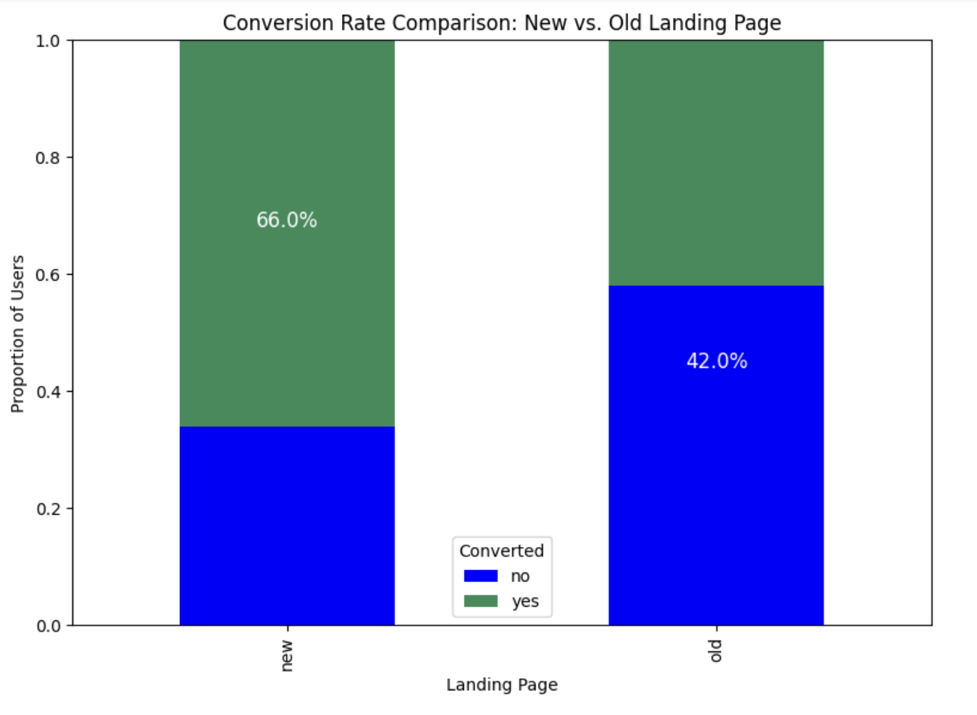

Executive Summary
New Landing Page Outperforms the Old
Language Preference Does Not Impact Conversion
The new landing page demonstrates a significantly higher conversion rate (66%) compared to the old landing page (42%), with a statistically significant difference (p-value = 0.008, α = 0.05).
There is no statistically significant relationship between a user's preferred language (English, French, Spanish) and their conversion status (p-value = 0.213, α = 0.05).
Time Spent on New Page Consistent Across Languages
The mean time spent on the new landing page is similar across English (6.66 minutes), French (6.20 minutes), and Spanish (5.84 minutes) users, with no statistically significant difference (p-value = 0.432, α = 0.05).

Slide 4





Business Recommendations
Implement New Landing Page
Roll out the new design across all user segments
Maintain Unified Approach
No need for language-specific optimizations
Continue Monitoring Performance
3
Track metrics to ensure sustained improvement
Since the new landing page performs better overall and user engagement (time spent) and conversion rates do not significantly vary by language, E-news Express should prioritize a full implementation of the new page across all user segments. Efforts should focus on further optimizing the new page's design to sustain and enhance its conversion performance.

Slide 5





Further Analysis Opportunities
User Demographics
Page Elements
Outlier Analysis
Investigate how age, location, and other demographic factors might influence conversion rates and engagement
Analyze which specific elements of the new page design contribute most to improved performance
Explore why some users spend significantly more or less time on the page to identify potential UX improvements
Device Compatibility
Examine if the new page performs equally well across different devices and screen sizes

Slide 6








Conclusion
Proven Effectiveness
Language Consistency
The new landing page significantly outperforms the old one in both engagement time and conversion rate
User behavior is consistent across language preferences, simplifying implementation strategy
Continuous Improvement
Clear Path Forward
Further analysis can identify additional optimization opportunities
E-news Express should proceed with full implementation of the new landing page design

Slide 7
Data Dictionary
user_id
group
Unique user ID of the person visiting the website
Whether the user belongs to the first group (control) or the second group (treatment)
landing_page
time_spent_on_the_page
Whether the landing page is new or old
Time (in minutes) spent by the user on the landing page
converted
language_preferred
Whether the user gets converted to a subscriber of the news portal or not
Language chosen by the user to view the landing page

Slide 8

Business Context
The advent of e-news, or electronic news, portals has offered us a great opportunity to quickly get updates on the day-to-day events occurring globally. The information on these portals is retrieved electronically from online databases, processed using a variety of software, and then transmitted to the users.
There are multiple advantages of transmitting new electronically, like faster access to the content and the ability to utilize different technologies such as audio, graphics, video, and other interactive elements that are either not being used or aren't common yet in traditional newspapers.
E-news Express, an online news portal, aims to expand its business by acquiring new subscribers. With every visitor to the website taking certain actions based on their interest, the company plans to analyze these actions to understand user interests and determine how to drive better engagement.

Slide 9





Key Questions
Do users spend more time on the new landing page?
Analyze if the redesigned page keeps visitors engaged longer
Is the conversion rate higher for the new page?
Determine if the new design leads to more subscriptions
Does conversion depend on preferred language?
Investigate if language preference affects subscription decisions
Is time spent consistent across language users?
Examine if different language users engage similarly with the new page

Slide 10

Solution Approach / Methodology
To address the key questions, a structured statistical analysis approach was employed, combining exploratory data analysis (EDA), visualizations, and hypothesis testing.

Slide 11
Solution - General Approach
Business Recommendations
Hypothesis Testing
Exploratory Data Analysis (EDA)
Data Preparation
Conclusions from the statistical tests were translated into actionable insights for E-news Express to improve its landing page strategy.
Appropriate statistical tests were selected based on the data types (categorical or continuous) and the number of groups being compared. Each test was conducted at α = 0.05, with p-values used to make decisions about the null hypotheses.
Descriptive statistics (e.g., means, proportions) and visualizations (e.g., bar charts, boxplots) were used to understand the data distributions and identify patterns before formal testing.
The dataset was filtered and segmented as needed for each question. For example, Question 2 used the full dataset (control and treatment groups), while Questions 3 and 4 focused on specific subsets (e.g., new page users for Question 4).

Slide 12




Solution - Detailed Methodology
Exploratory Data Analysis (EDA)
Statistical Hypothesis Testing
Univariate and bivariate visualizations (histograms, boxplots, bar charts)
Independent t-test: To compare average time spent between old and new landing pages
Summary statistics and initial insights
Two-proportion z-test: To compare conversion rates between page versions
Chi-square test: To test independence between conversion status and language
Data Preparation
Filtered data for new vs. old page groups
One-way ANOVA: To compare mean time spent across language groups (on the new page)
Grouped users by preferred language
Extracted conversion status and time spent values
All tests were performed after checking key assumptions (normality and equal variances using Shapiro-Wilk and Levene's tests)

Slide 13

Experimental Design
Random Selection
100 users were randomly selected and divided equally into two groups
Control vs Treatment
The existing landing page was served to the first group (control group) and the new landing page to the second group (treatment group)
Data Collection
Data regarding user interaction with both versions of the landing page was collected for analysis

Slide 14
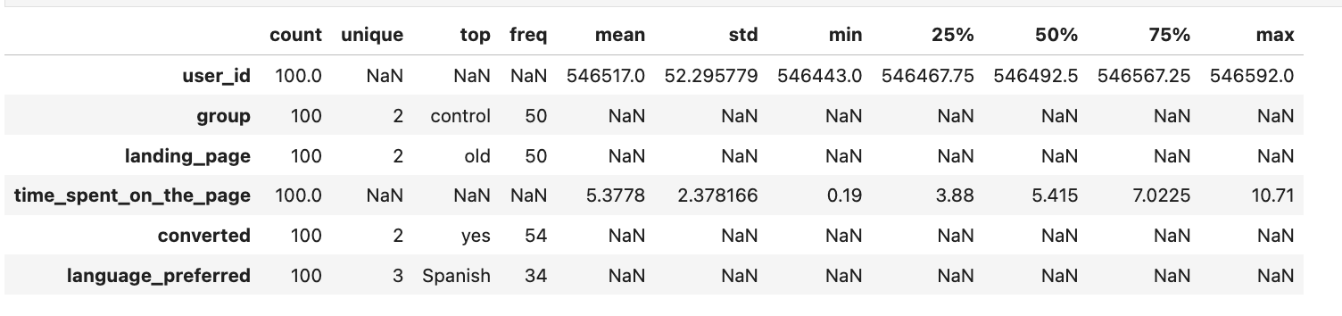
Data Overview
Dataset Shape
Key Statistics
100 rows (users) and 6 columns (variables)
Time spent on page:
Data Quality
Mean: 5.38 minutes
No missing values
Minimum: 0.19 minutes
No duplicate records
Maximum: 10.71 minutes
Clean data ready for analysis
Standard deviation: 2.38 minutes

Slide 15
Univariate Analysis General Observations
Balanced groups and pages:
The group and landing page are evenly split (50/50), so the experiment was well designed.
Balanced language preference:
There are roughly equal numbers of users in Spanish, French, and English—this will help ensure fairness when comparing languages later.
Conversion Rate is slightly skewed:
More users said “yes” to being converted (54%) than “no” (46%). This could be good news for the business, but it needs hypothesis testing.
Time spent distribution is fairly symmetric:
Based on the histogram and boxplot, most users spend 3 to 8 minutes on the page, with very few outliers.
No clear visual class imbalance:
This supports fair hypothesis testing.

Slide 16
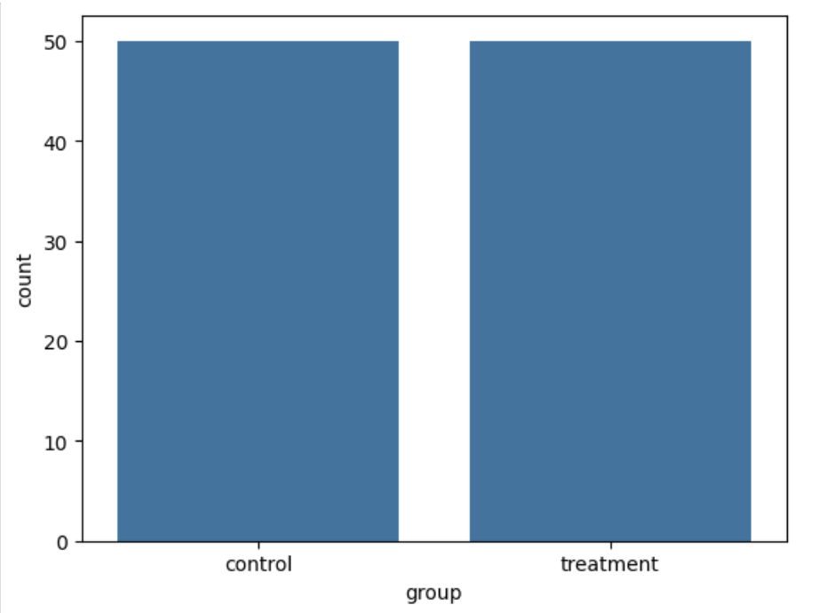
Group Distribution – Balanced Groups & Pages
Random Selection
100 users were randomly selected and divided equally into two groups
Control vs Treatment
The existing landing page was served to the first group (control group) and the new landing page to the second group (treatment group)
The experiment was designed with a perfect 50/50 split between the control group (old landing page) and the treatment group (new landing page), ensuring a balanced representation for statistical comparison.
Data Collection
Data regarding user interaction with both versions of the landing page was collected for analysis

Slide 17
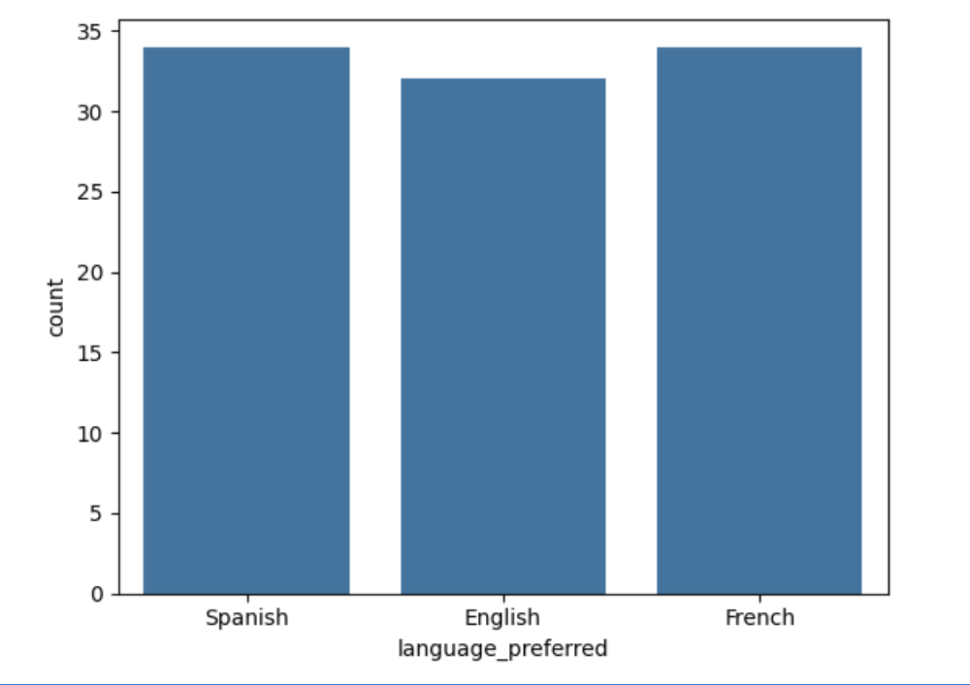
Balanced Language Preference Distribution
The distribution of language preferences among users is relatively balanced, with Spanish and French each representing 34% of users, while English accounts for 32%. This balanced distribution helps ensure fair comparison across language groups in our analysis.

Slide 18
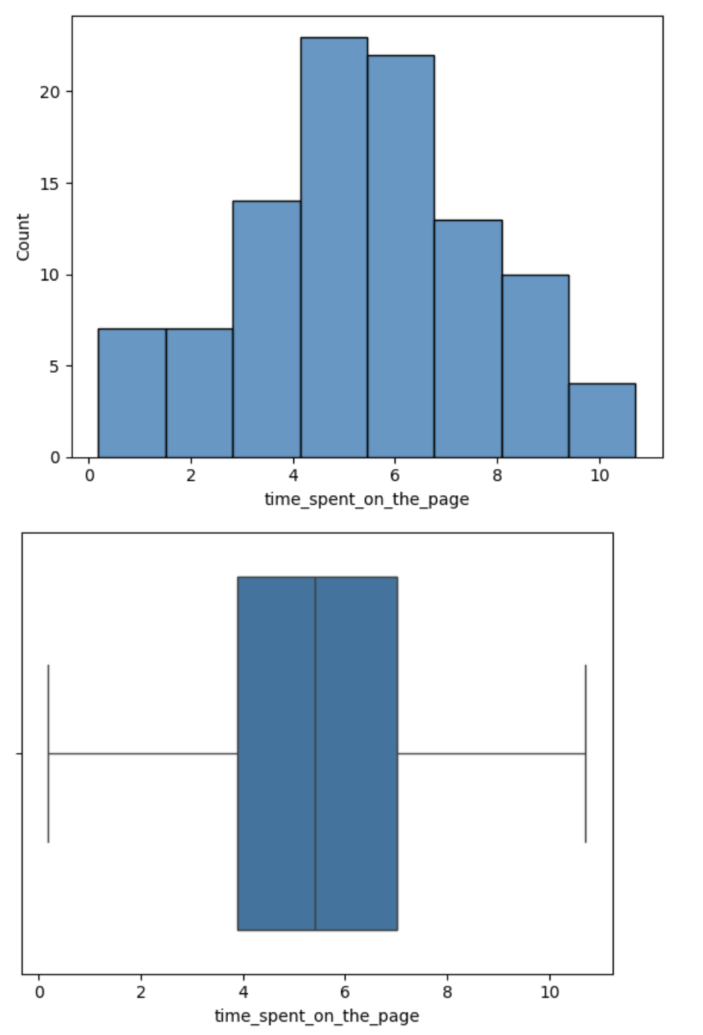
Time Spent Distribution
The distribution of time spent on the page reveals two distinct user behaviors: a smaller group of users who spend a short time (1-2 minutes) and a larger group who spend a moderate time (5-6 minutes), with a median of around 5 minutes.
This bimodal pattern suggests that E-news Express has a mix of users—those who quickly skim the page and leave and those who engage more deeply with the content. The lack of extreme outliers indicates that the time spent by users, even at the extremes, is within the expected range.

Slide 19
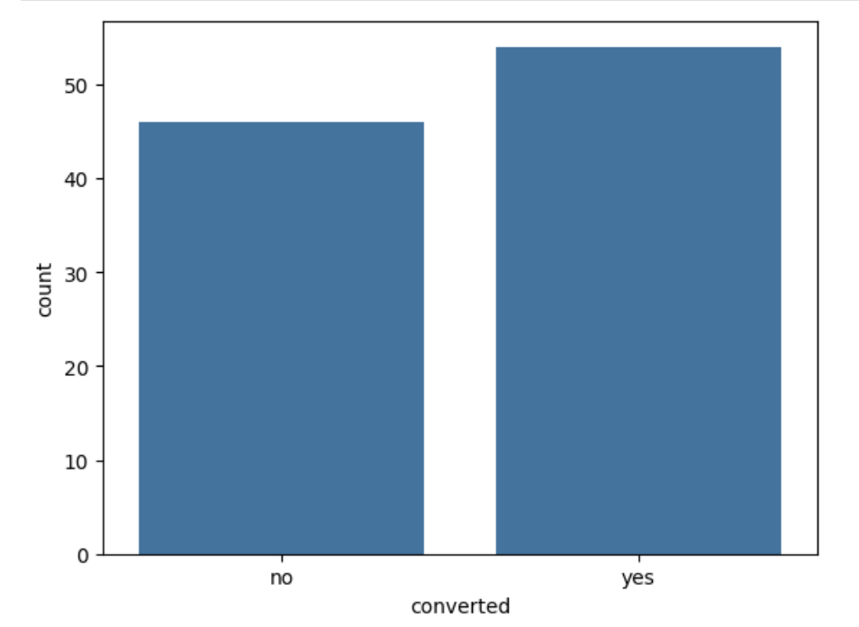
Time Spent by Landing Page Type
Users spent significantly more time on the new landing page (an average of 6.23 minutes) than on the old landing page (an average of 4.52 minutes). This visual comparison suggests that the new design is more engaging, keeping users on the page longer.

Slide 20
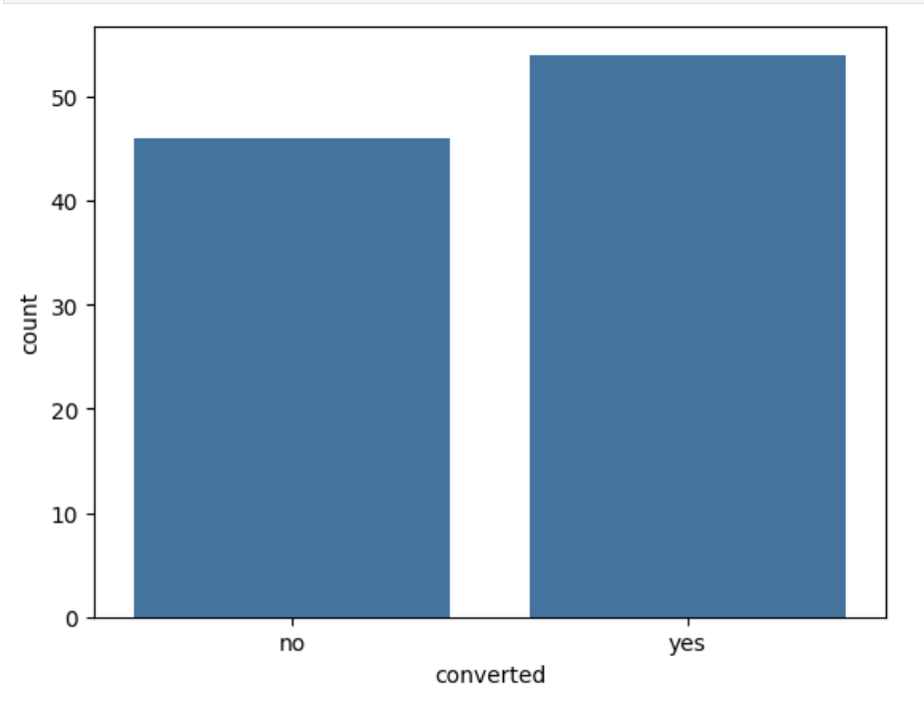
Conversion Status Distribution - Conversion Rate is slightly skewed
54%
Converted
Users who subscribed
46%
Not Converted
Users who did not subscribe
Overall, the experiment showed a positive conversion rate with more users subscribing (54%) than not subscribing (46%). This suggests generally effective landing pages, but further analysis is needed to determine which version performs better.

Slide 21
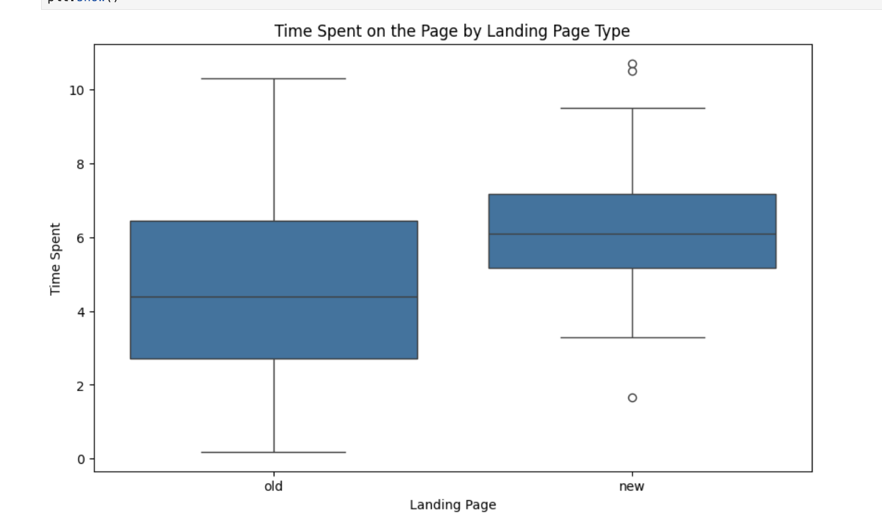
Bivariate Analysis - Landing Page vs Time Spent on the Page
Observation | Interpretation
Higher Median for New Page | Users tend to spend more time on the new landing page (median shifted upward).
Less Spread in New Page | The interquartile range (IQR) is narrower, indicating more consistent engagement on the new page.
Outliers | A few users spent unusually high or low time (dots above/below the whiskers), which is normal in user behavior data.
Higher Overall Distribution | The new page’s entire box is shifted upward compared to the old — not just the median, but also Q1 and Q3.
Overall conclusion. The new landing page appears to increase average user engagement and makes user behavior more consistent. This visual supports the t-test result which showed that the increase in time spent was statistically significant.

Slide 22
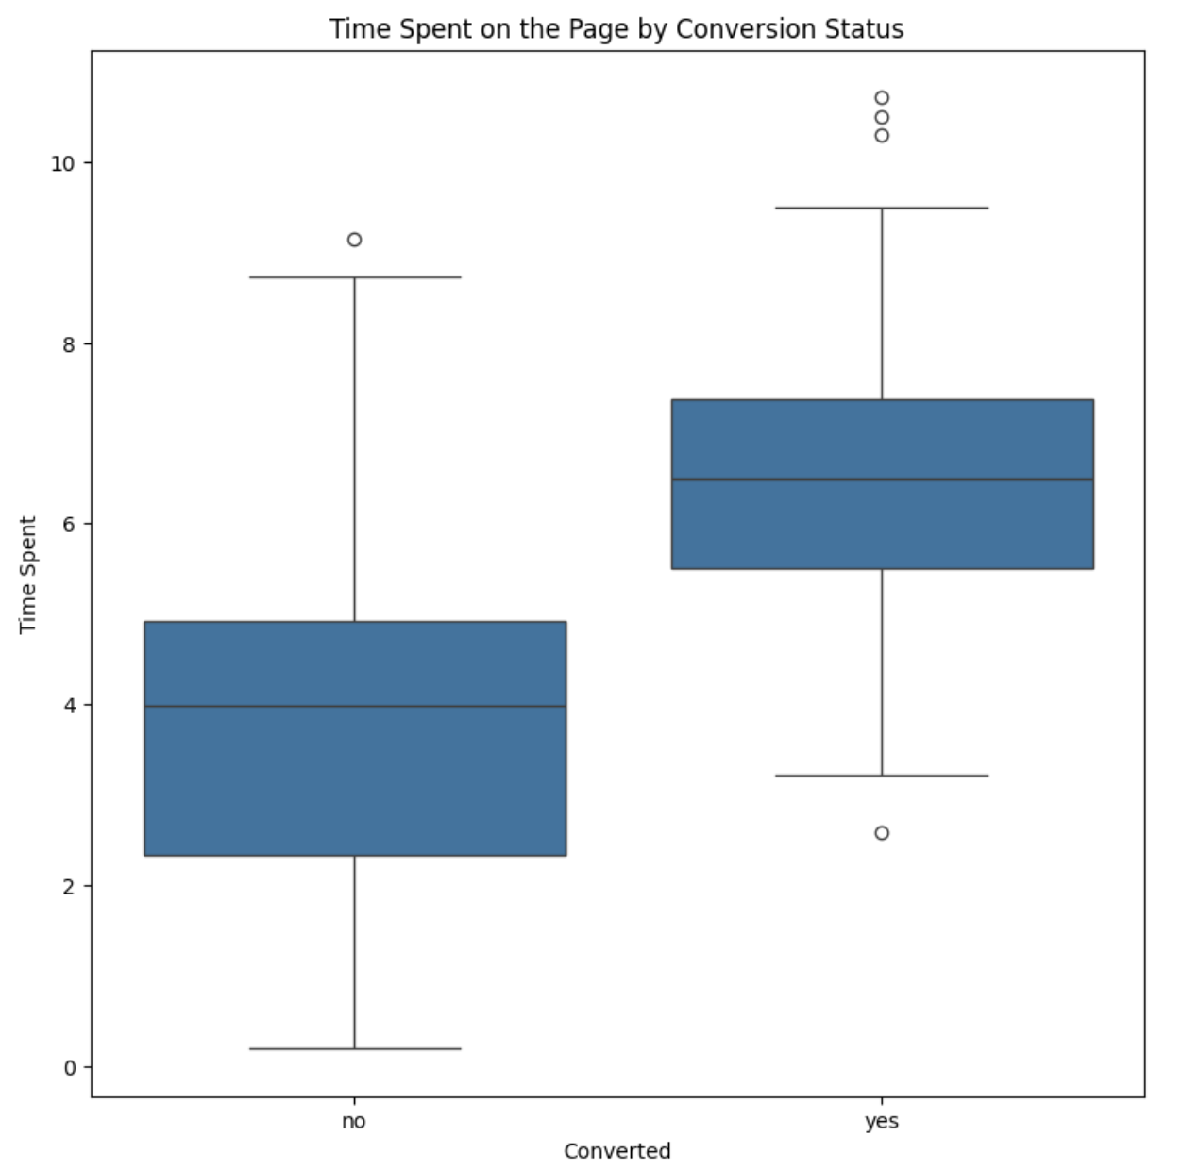
Bivariate Analysis - Conversion Status vs Time Spent on the Page
Observation | Interpretation
Higher Median for Converters | Users who converted spent more time on the page (median approx. 6.8) than those who didn’t (Approx. 4.0).
Greater Upper Range in ‘Yes’ Group | Converted users not only spent more time, but also had more high-end engagement (Q3 is higher).
Tighter IQR in ‘Yes’ Group | Time spent by converters is more concentrated, suggesting a typical engagement pattern before conversion.
Outliers in Both Groups | Normal behavior — but doesn’t distort the conclusion due to the robust medians and IQR.
Overall Conclusion: There is a positive association between time spent on the page and the likelihood of conversion. Users who spend more time on the landing page are more likely to convert. This supports potential strategies like:
Optimising content to hold attention longer.
Tracking scroll depth or click interactions as part of a conversion funnel.

Slide 23
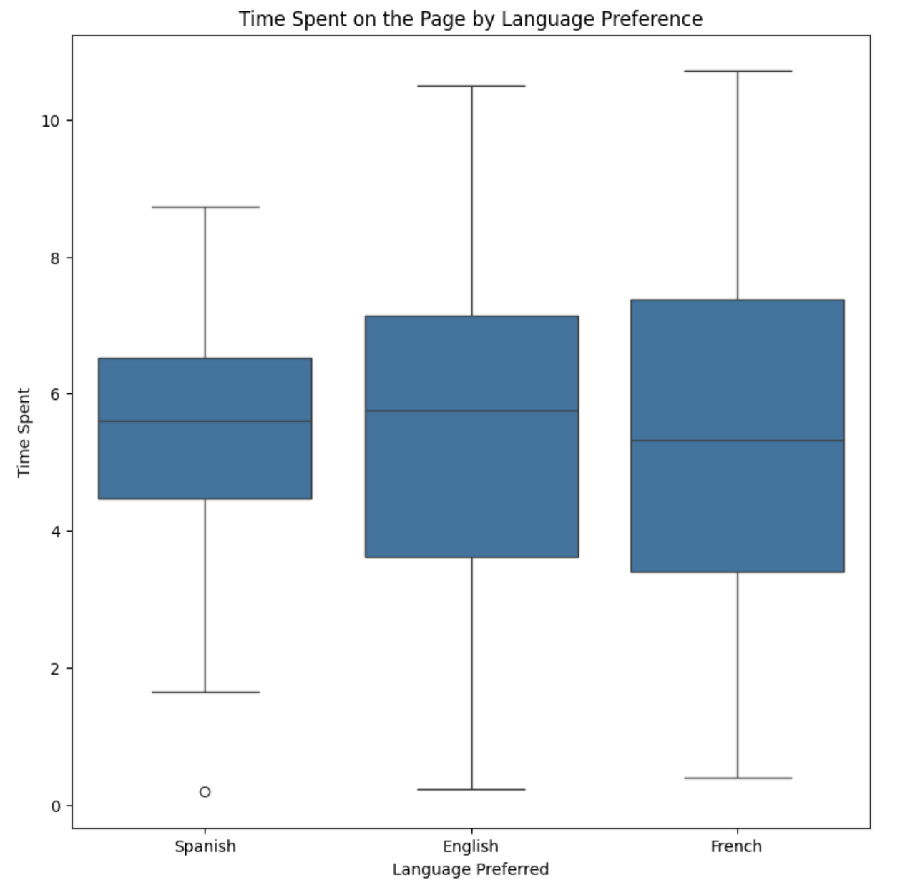
Bivariate Analysis - Language Preferred vs Time Spent on the Page
All three language groups have similar median time spent (5.5–5.8 minutes).
The distributions overlap significantly, and no group stands out clearly.
French and English have more variability, while Spanish shows more consistent behavior.
Language | Median | Spread | Outliers | Observation
Spanish | Slightly higher median (5.6) | Narrower spread | Few low outliers | Users are more consistent in their time spent
English | Median 5.8 | Widespread | Outliers on both ends | Broad range in user engagement
French | Median slightly lower (5.4–5.5) | Similar spread to English | Outliers | Slightly more variability in behavior

Slide 24
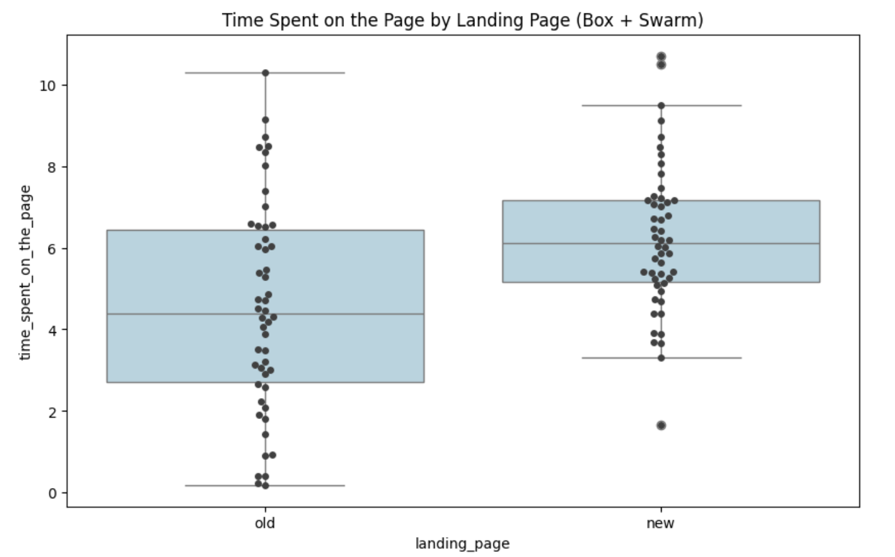
Bivariate Analysis - Swarm plot overlay on Boxplot for clarity
Feature | Observation | Interpretation
Median | Higher for new page | On average, users spend more time on the new landing page
IQR (box width) | Narrower in the new group | Time spent is more consistent across users on the new page
Outliers | More in old page | Greater variability in user engagement for the old version
Swarm (dots) | New page has more tightly packed dots around the center | Most users cluster around the 6-minute mark for the new page, while the old page is more spread out
Overall shape | The new page group is shifted upward | Suggests better engagement with the new design
This box + swarm plot clearly supports the idea that the new landing page performs better in terms of user engagement. It visually shows a higher central tendency and tighter clustering in the new group, but we will still conduct statistical analysis to prove this.

Slide 25



Q1 Hypothesis Test: Do the users spend more time on the new landing page than the existing landing page?
Null Hypothesis (H₀)
The average time spent on the new page is less than or equal to that of the old page
Test Selection
Independent Samples t-Test (One-Tailed) with unequal variances
Results
p-value = 0.000139, which is less than α = 0.05
Null Hypothesis (H₀): (The Status Quo) The average time spent on the new page is less than or equal to that of the old page.
Alternative Hypothesis (H₁): (Claim) The average time spent on the new page is greater than that of the old page.
Link to Appendix slide on details of the test performed

Slide 26
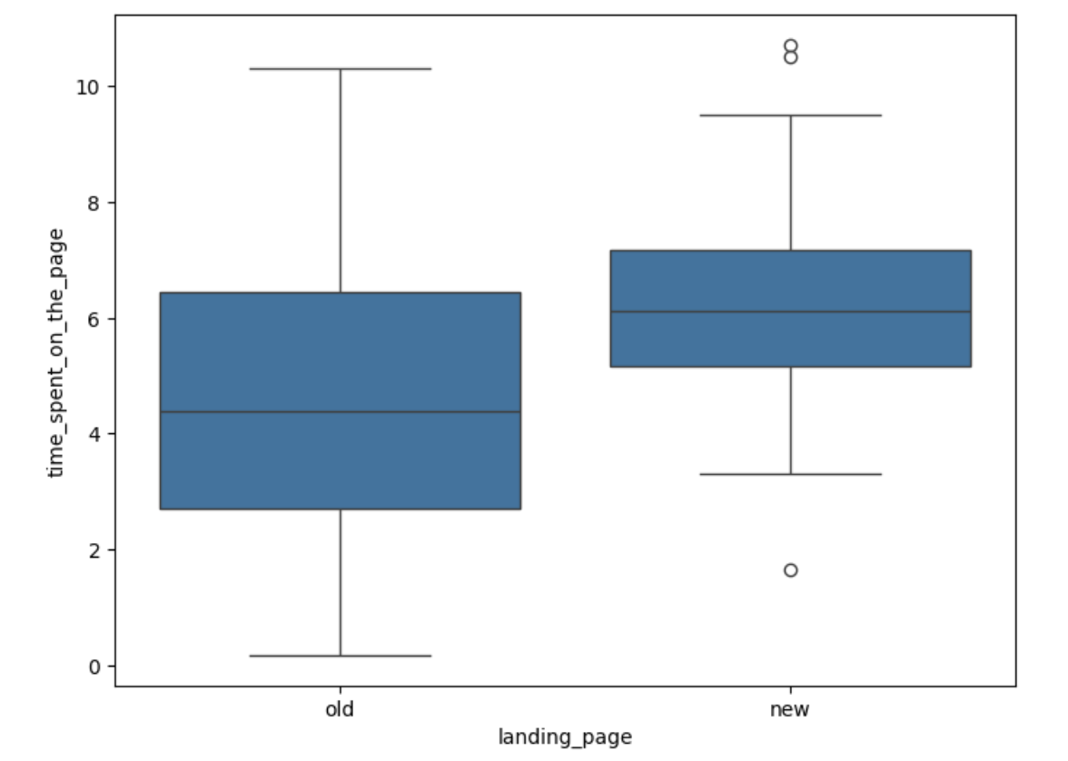
Q1 – Hypothesis Test: Do the users spend more time on the new landing page than the existing landing page?
This is a one-tailed test concerning the difference between two population means from two independent groups (users who saw the old landing page vs. those who saw the new one).
Since the population standard deviations are unknown and the sample sizes are relatively small, we use the:
Independent Samples t-Test (One-Tailed)
This test will help determine whether the mean time spent on the new landing page is significantly greater than that on the old page.
Significance of the test | Assumptions met? Yes | Test Statistic Distribution
Test for population mean H₀ : 𝜇 = 𝜇₀ | Continuous data Normally distributed population and sample size < 30 Unknown population standard deviation Random sampling from the population | t distribution (The test is also known as One-sample t-test)

Slide 27
Time Spent Analysis Conclusion
Statistical Finding
Business Insight
We reject the null hypothesis. There is statistically significant evidence that users spend more time on the new landing page compared to the old one (p-value = 0.000139 < α = 0.05).
The new landing page is more engaging and effective at holding user attention. This supports moving forward with its broader rollout to enhance user engagement.
Standard Deviations
Remember that if the P Value is low, the Null hypothesis must go.
New page: 1.82 minutes
Old page: 2.58 minutes
The lower standard deviation for the new page indicates more consistent user engagement.

Slide 28
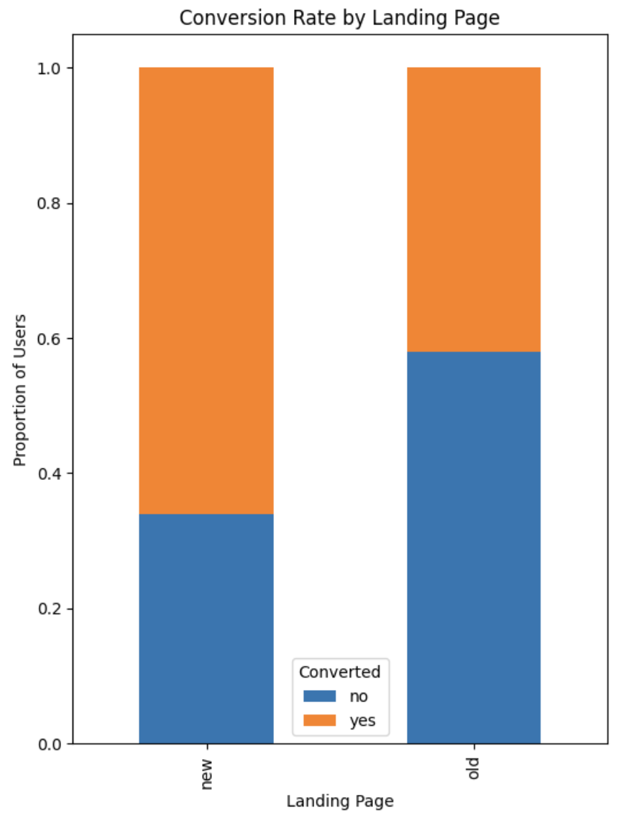
Q2 Hypothesis Test: Is the conversion rate (the proportion of users who visit the landing page and get converted) for the new page greater than the conversion rate for the old page?
The new landing page shows a substantially higher conversion rate (66%) compared to the old landing page (42%). This visual comparison suggests the new design is more effective at converting visitors to subscribers. Which will be formally tested.
Selecting appropriate test:
We are comparing the conversion rates (proportions of users who were converted) between two independent groups — users who saw the new landing page and those who saw the old one.
Since the outcome is binary (Yes or No), and we are comparing two independent proportions, the appropriate statistical test is:
Two-Proportion Z-Test (One-Tailed)
This will allow us to test if the conversion rate for the new page is significantly greater than that for the old page.
Assumptions are met?
Binomially distributed populations
Independent populations
Random sampling from the populations
When both mean (np) and n(1-p) are greater than or equal to 10. The binomial distribution can be approximated by a normal distribution

Slide 29



Hypothesis Test: Conversion Rate
Null Hypothesis (H₀)
There is no improvement in conversion rate on the new page
Test Selection
Two-Proportion Z-Test (One-Tailed)
Results
Z-statistic = 2.41, p-value = 0.0080, which is less than α = 0.05
Null Hypothesis (H₀): (The Status Quo) There is no improvement in conversion rate on the new page
Alternative Hypothesis (H₁): (Claim) The new page has a higher conversion rate than the old page..
Link to Appendix slide on details of the test performed

Slide 30
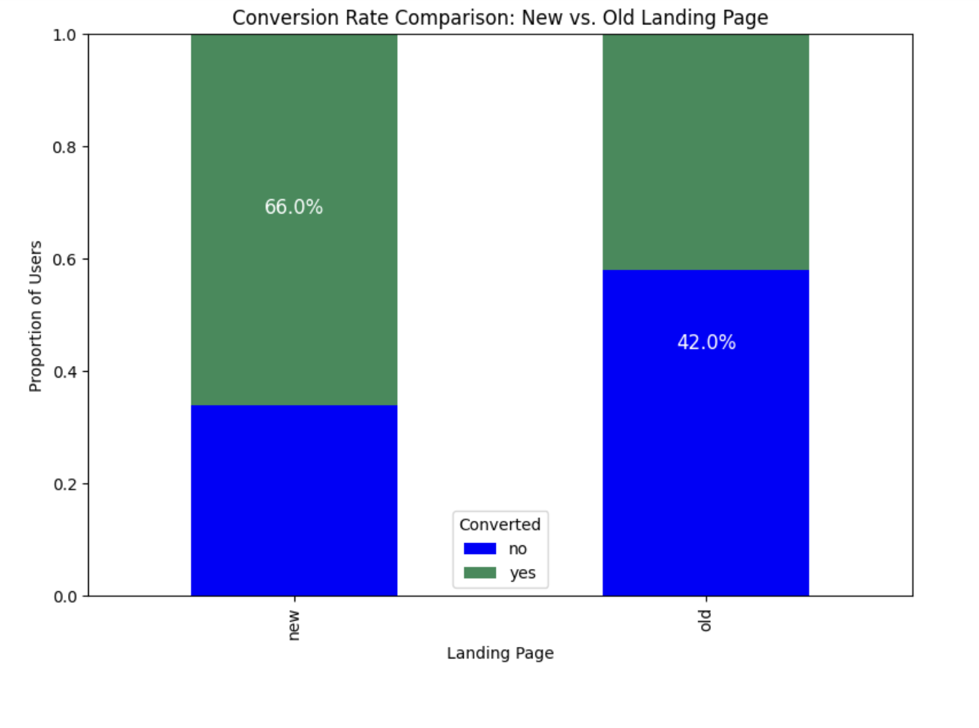
Conversion Rate Analysis Conclusion
Statistical Finding
Business Recommendation
We reject the null hypothesis. There is statistically significant evidence that the conversion rate for the new landing page is greater than that for the old landing page (p-value = 0.0080 < α = 0.05).
The new landing page is performing significantly better in terms of conversions. E-news Express should consider a wider rollout of the new landing page to enhance user engagement and increase subscription rates.
Impact Measurement
The new page shows a 24 percentage point improvement in conversion rate, which represents a 57% increase relative to the old page's performance.
Remember that if the P-Value is low, the Null hypothesis must go.

Slide 31
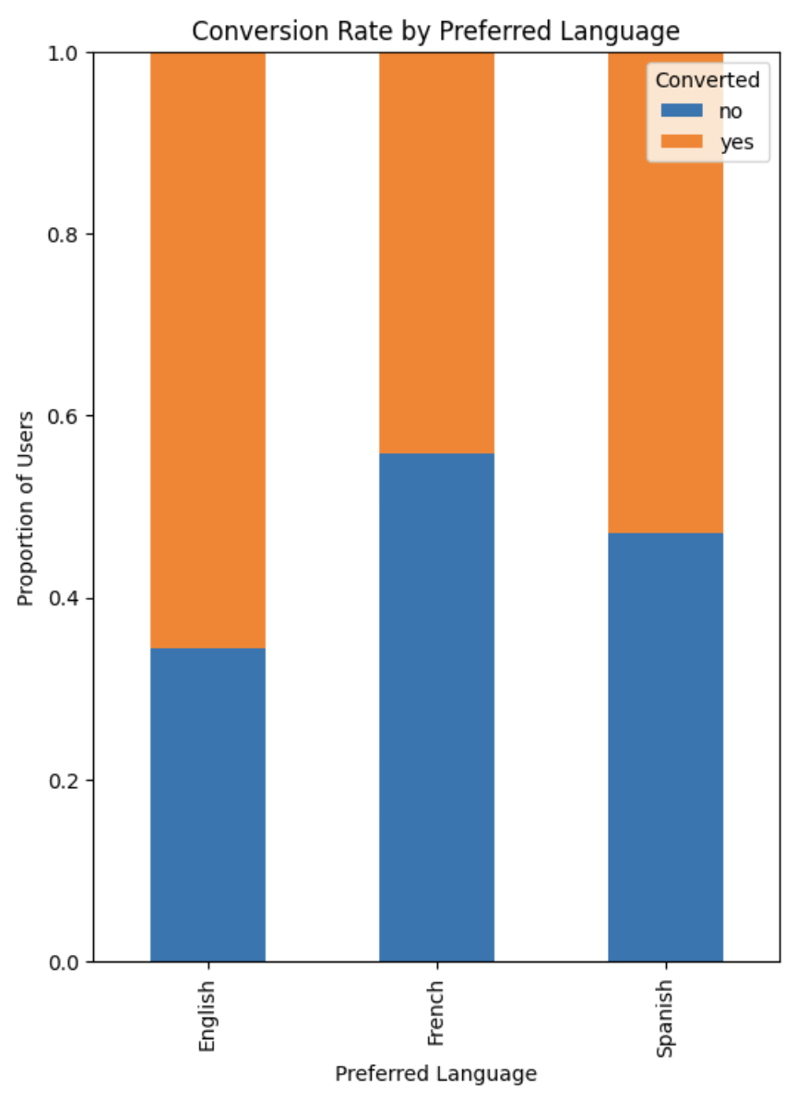
Q3 – Hypothesis Test: Is the conversion and preferred language are independent or related?
The chart shows variation in conversion rates across language preferences:
Each bar represents a preferred language group, broken down by the proportion of users who converted (yes) and did not convert (no).
English appears to have the highest conversion rate (more orange, less blue).
French shows the lowest conversion rate (more blue, less orange).
Spanish is somewhere in between, leaning toward a low conversion rate. There are visible differences in conversion rates across the language groups, which suggests a possible dependency between converted and language_preferred.
But — to confirm whether these differences are statistically significant, we need to do some tests.

Slide 32



Hypothesis Test: Language vs Conversion
Null Hypothesis (H₀)
Conversion status is independent of preferred language
Test Selection
Chi-Square Test of Independence
Results
p-value = 0.213, which is greater than α = 0.05
Null Hypothesis (H₀): (The Status Quo) Conversion status is independent of preferred language.
Alternative Hypothesis (H₁): (Claim) The new page has a higher conversion rate than the old page..
Link to Appendix slide on details of the test performed

Slide 33
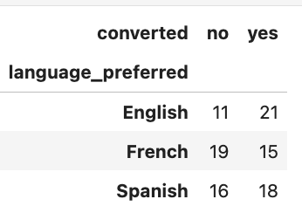
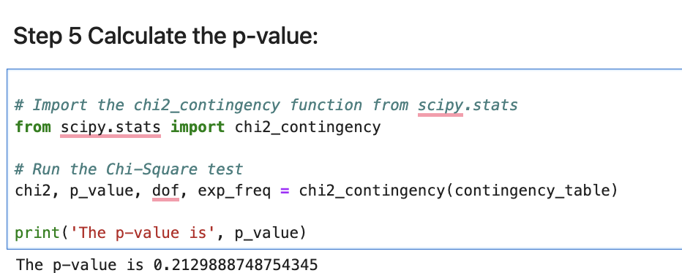
Contingency Table: Language vs Conversion
Significance of the test | Assumptions met? Yes | Test Statistic Distribution
In a contingency table H₀ : The row and column variables are independent | Categorical variables Expected value of the number of sample observations in each level of the variable is at least 5 Random sampling from the population | Chi Square distribution (The test is also known as Chi-square test of independence)
This contingency table shows the distribution of conversion status across different language preferences.
While there appear to be some differences in conversion rates (English: 66%, Spanish: 53%, French: 44%), we need to test if these differences are statistically significant.

Slide 34
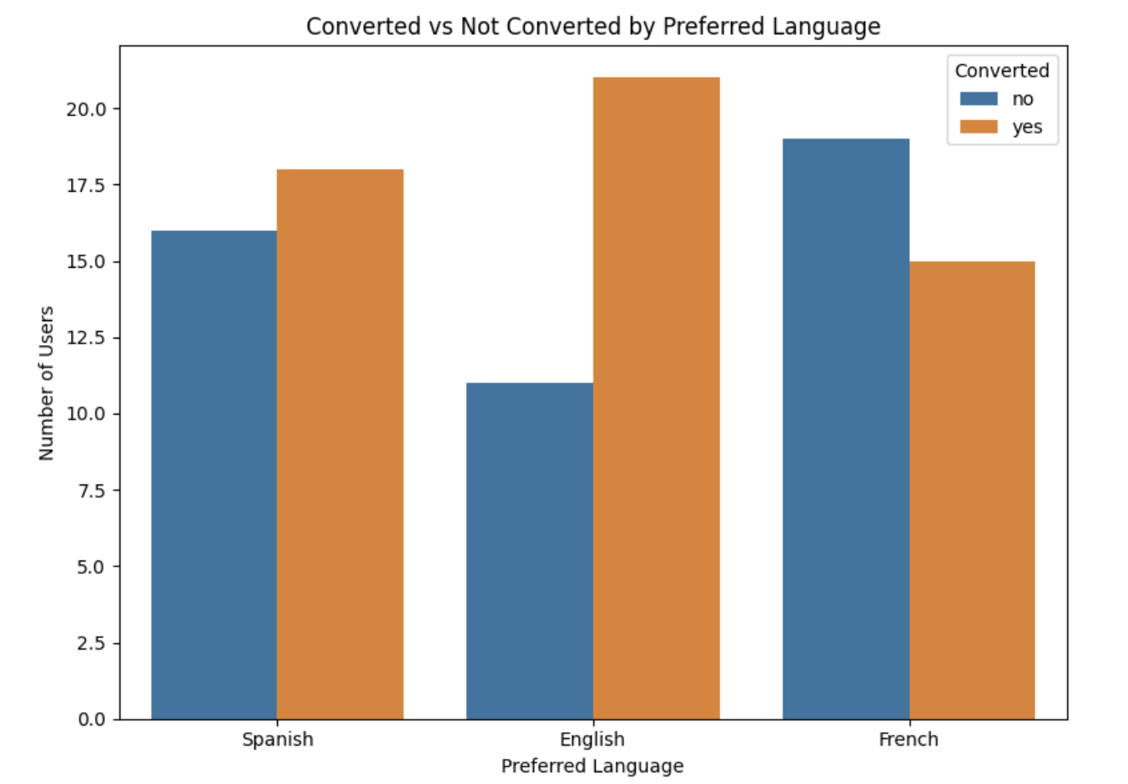
Language vs Conversion Analysis Conclusion
Statistical Finding
Business Recommendation
Further Consideration
We fail to reject the null hypothesis.
There is no statistically significant relationship between a user's preferred language and whether or not they converted (p-value = 0.213 > α = 0.05).
Resources should focus on improving overall page effectiveness rather than tailoring landing pages by language based on conversion data alone.
The apparent differences in conversion rates across languages are not statistically significant.
While conversion rates don't significantly differ by language, other metrics like user satisfaction or specific content engagement might still vary and could be worth investigating separately.
Visual Insight
The grouped bar chart shows some variation in conversion rates across languages — with English users converting more frequently than French or Spanish users.
However, this visual difference is not statistically significant, as confirmed by the chi-square test (p = 0.213).

Slide 35
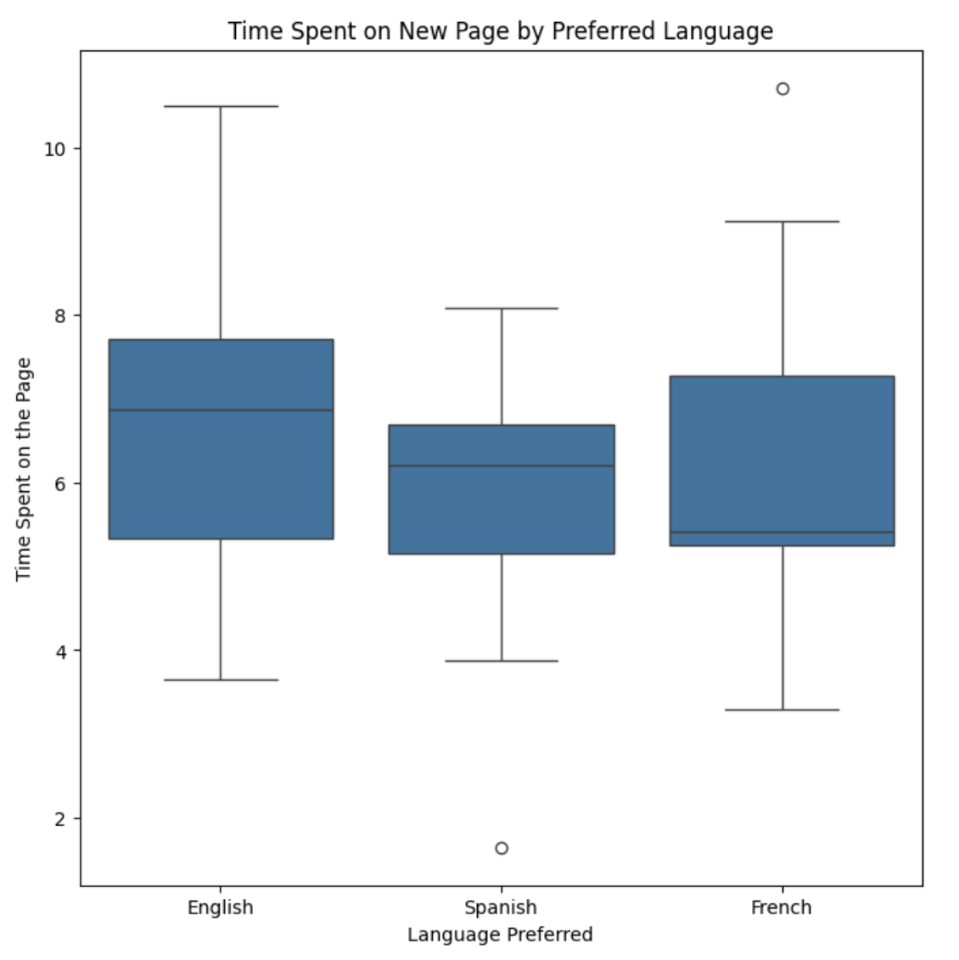
Q4 – Hypothesis Test: Is the time spent on the new page same for the different language users?
The boxplot visualisation shows the distribution of time spent on the new landing page across language groups.
While English users appear to spend more time on average, there is considerable overlap in the distributions.
Spanish users show the least variability (tightest box).
While French users show more spread with one high outlier.
Numerical insights on average
English (6.66 minutes), followed by French (6.20 minutes) and Spanish (5.84 minutes) users.
While there are visible differences, statistical testing is needed to determine if these differences are significant.

Slide 36



Is the time spent on the new page same for the different language users?
Null Hypothesis (H₀)
Mean time spent is the same across all language groups
Test Selection
One-Way ANOVA (Analysis of Variance)
Results
F-statistic = 0.8544, p-value = 0.432, which is greater than α = 0.05
Null Hypothesis (H₀): (The Status Quo) Mean time spent is the same across all language groups
Alternative Hypothesis (H₁): (Claim) At least one group has a mean time spent that is different.
Link to Appendix slide on details of the test performed

Slide 37
Selecting the Appropriate Test
We are comparing the mean time spent on the new landing page across three independent language groups (English, French, and Spanish).
The response variable (time_spent_on_the_page) is continuous, and the grouping variable (language_preferred) is categorical with more than two groups.
Therefore, the appropriate test is:
One-Way ANOVA (Analysis of Variance)
This test will help us determine whether there is a statistically significant difference in mean time spent across the different language groups.
We will proceed to check the assumptions of ANOVA (normality and equal variance) before conducting the test.
Significance of the test | Assumptions met? We will need to verify | Test Statistic Distribution
Test for means for more than two populations H₀ : All population means are equal | The populations are normally distributed Samples are independent simple random samples Population variances are equal | F distribution (The test is also known as One-way ANOVA F-test)

Slide 38
Check Assumptions
Shapiro-Wilk test
Levene’s test
“Shapiro-Wilk’s test is applied to the response variable to validate the normality assumption. The Shapiro-Wilk test examines if the population from which the sample is drawn follows a normal distribution or not.”
“Levene's test is applied to the different groups to validate the common variance assumption. It checks whether different samples are drawn from a population with a common variance.”
I applied the Shapiro-Wilk test to assess whether the ”time_spent_on_the_page” variable is normally distributed within each language group
The next step is to use Levene’s test to check the second key ANOVA assumption: equal variances across groups.
Levene’s Test was used to assess the assumption of homogeneity of variances across language groups.
p-value = 0.467
Since the p-value is greater than 0.05, we conclude that the variances are equal. The assumption of equal variance is satisfied.
Language | p-value | Result
English | 0.886 | Normal
French | 0.321 | Normal
Spanish | 0.090 | Normal
All p-values are greater than 0.05, so the normality assumption for ANOVA is satisfied.

Slide 39
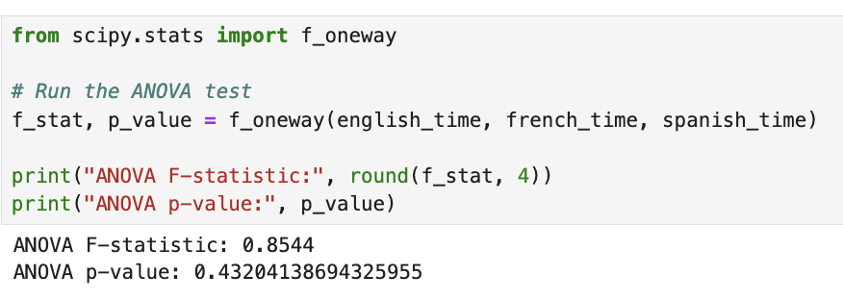
Time Spent by Language Analysis Conclusion
Statistical Finding
Business Recommendation
We fail to reject the null hypothesis. There is no statistically significant difference in the mean time spent on the new landing page across English, French, and Spanish users (p-value = 0.432 > α = 0.05).
All language groups appear to engage similarly with the new landing page. No localization changes are needed based on time-spent behavior, as the differences observed are not statistically significant.
Assumption Verification
The ANOVA assumptions were verified: normality was confirmed with Shapiro-Wilk tests (all p-values > 0.05) and equal variance was confirmed with Levene's test (p-value = 0.467 > 0.05).

Slide 40




Key Findings Summary
Time Spent Analysis
Users spend significantly more time on the new landing page compared to the old one (p-value = 0.000139 < α = 0.05)
2
Conversion Rate Analysis
The new landing page has a significantly higher conversion rate (66%) than the old page (42%) with p-value = 0.008 < α = 0.05
Language Impact on Conversion
No statistically significant relationship between language preference and conversion status (p-value = 0.213 > α = 0.05)
Language Impact on Time Spent
No statistically significant difference in time spent on the new page across language groups (p-value = 0.432 > α = 0.05)

Slide 41





Considerations on the
Limitations of the study
Sample Size
The study used 100 users (50 per group), which may limit the statistical power to detect smaller effects, especially in subgroup analyses
Time Frame
The analysis represents a snapshot in time and may not account for seasonal variations in user behavior
Limited Variables
The study focused on a few key metrics and may not capture all factors influencing user decisions
Geographic Considerations
The analysis did not account for potential regional differences in user behavior beyond language preference

Slide 42
APPENDIX

Slide 43
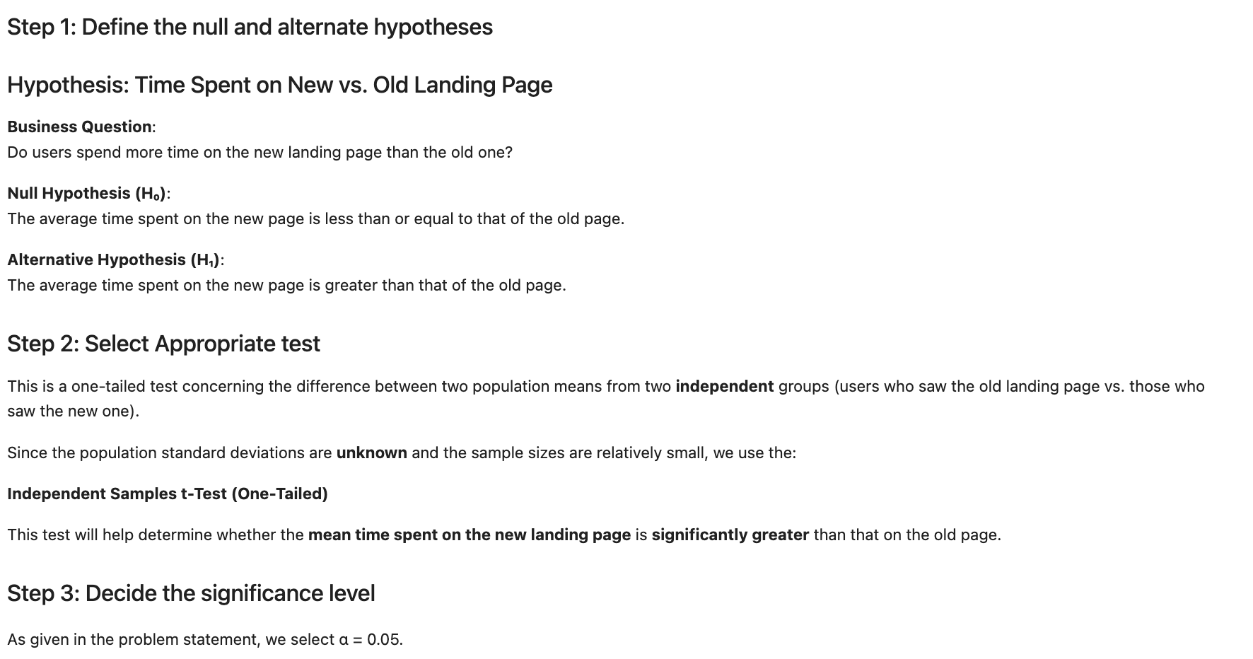
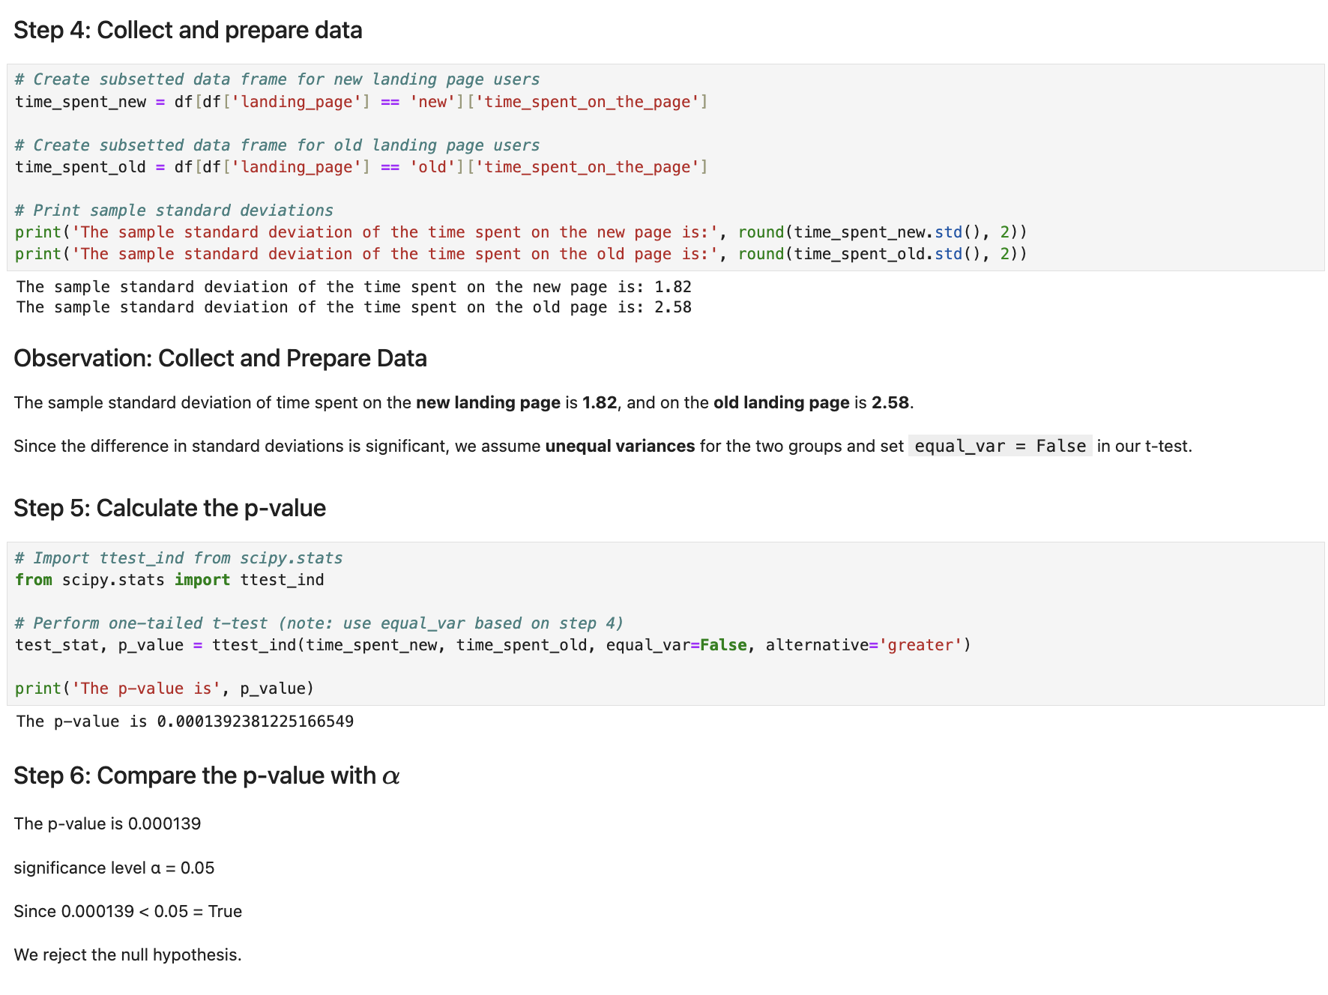
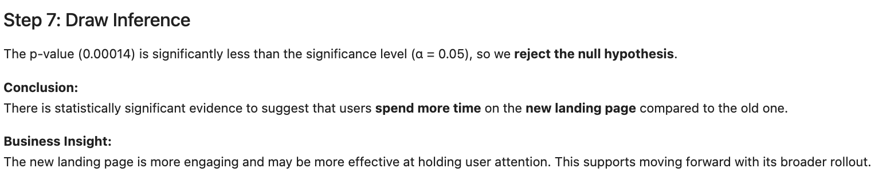
Question 1 Hypothesis Testing Details

Slide 44
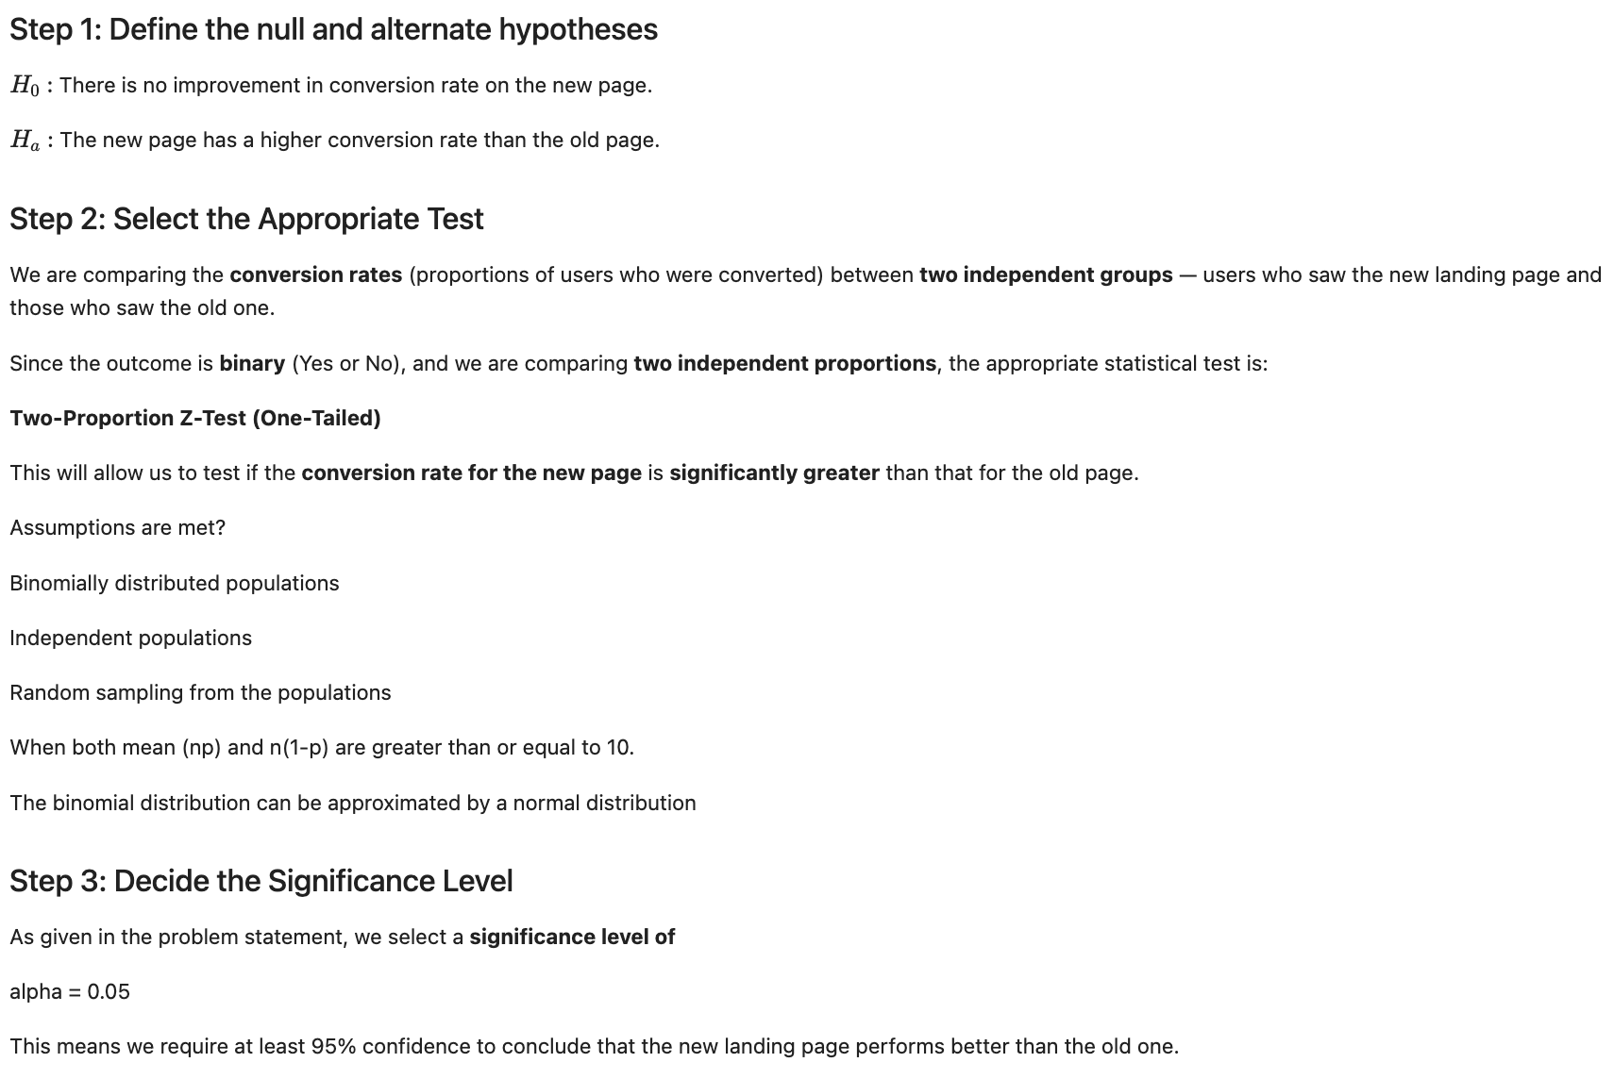
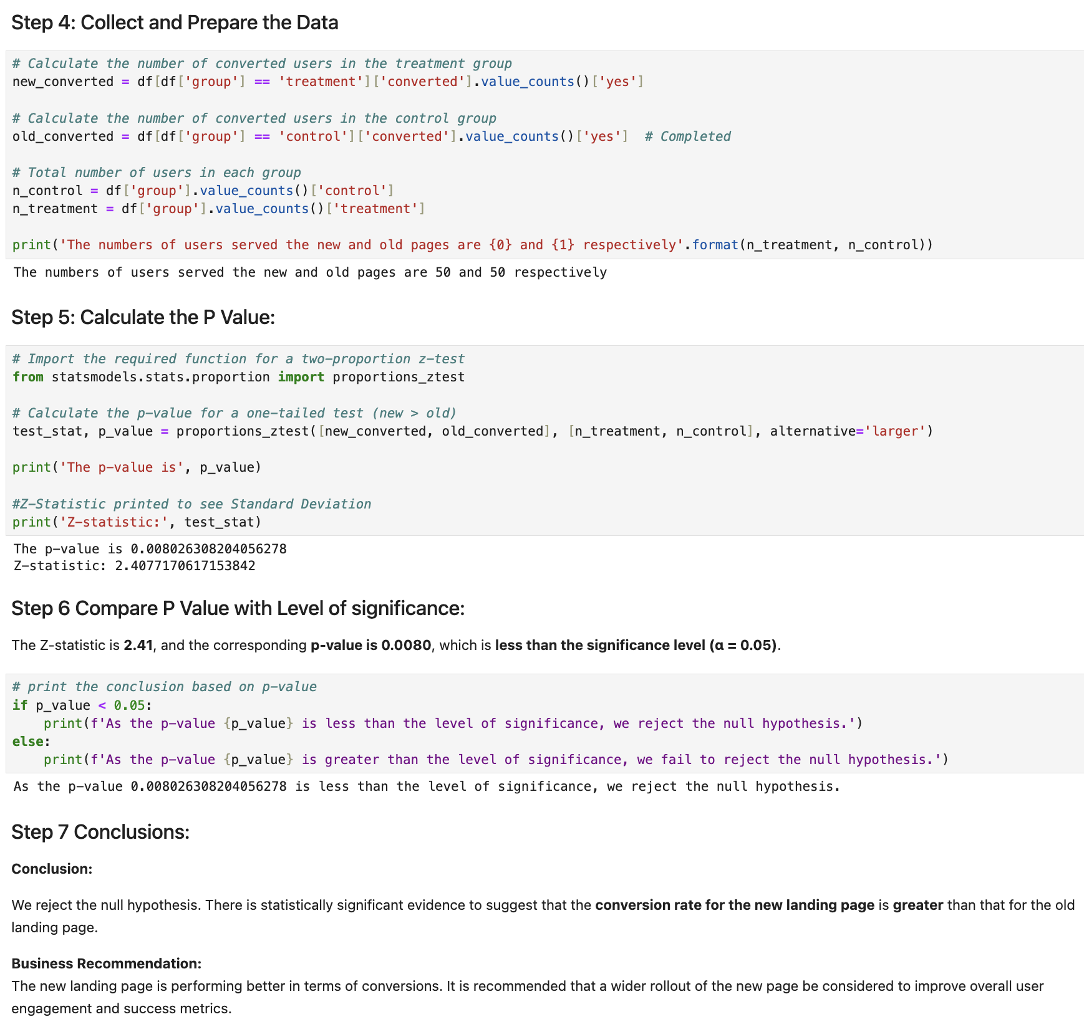
Question 2 Hypothesis Testing Details

Slide 45
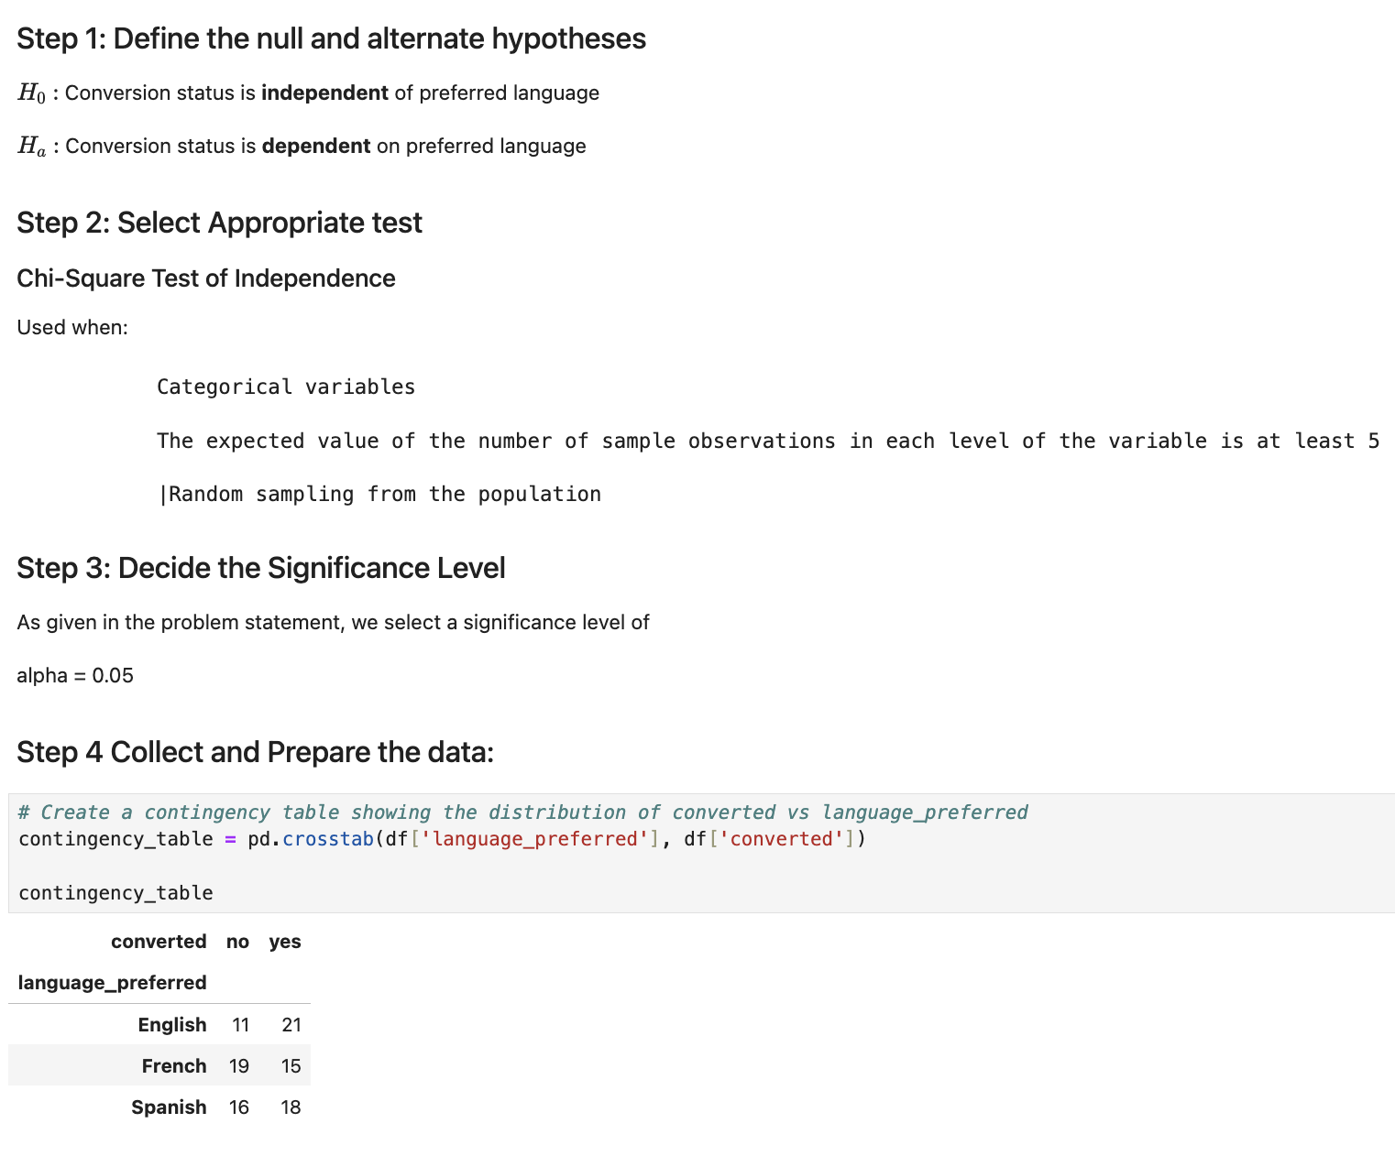
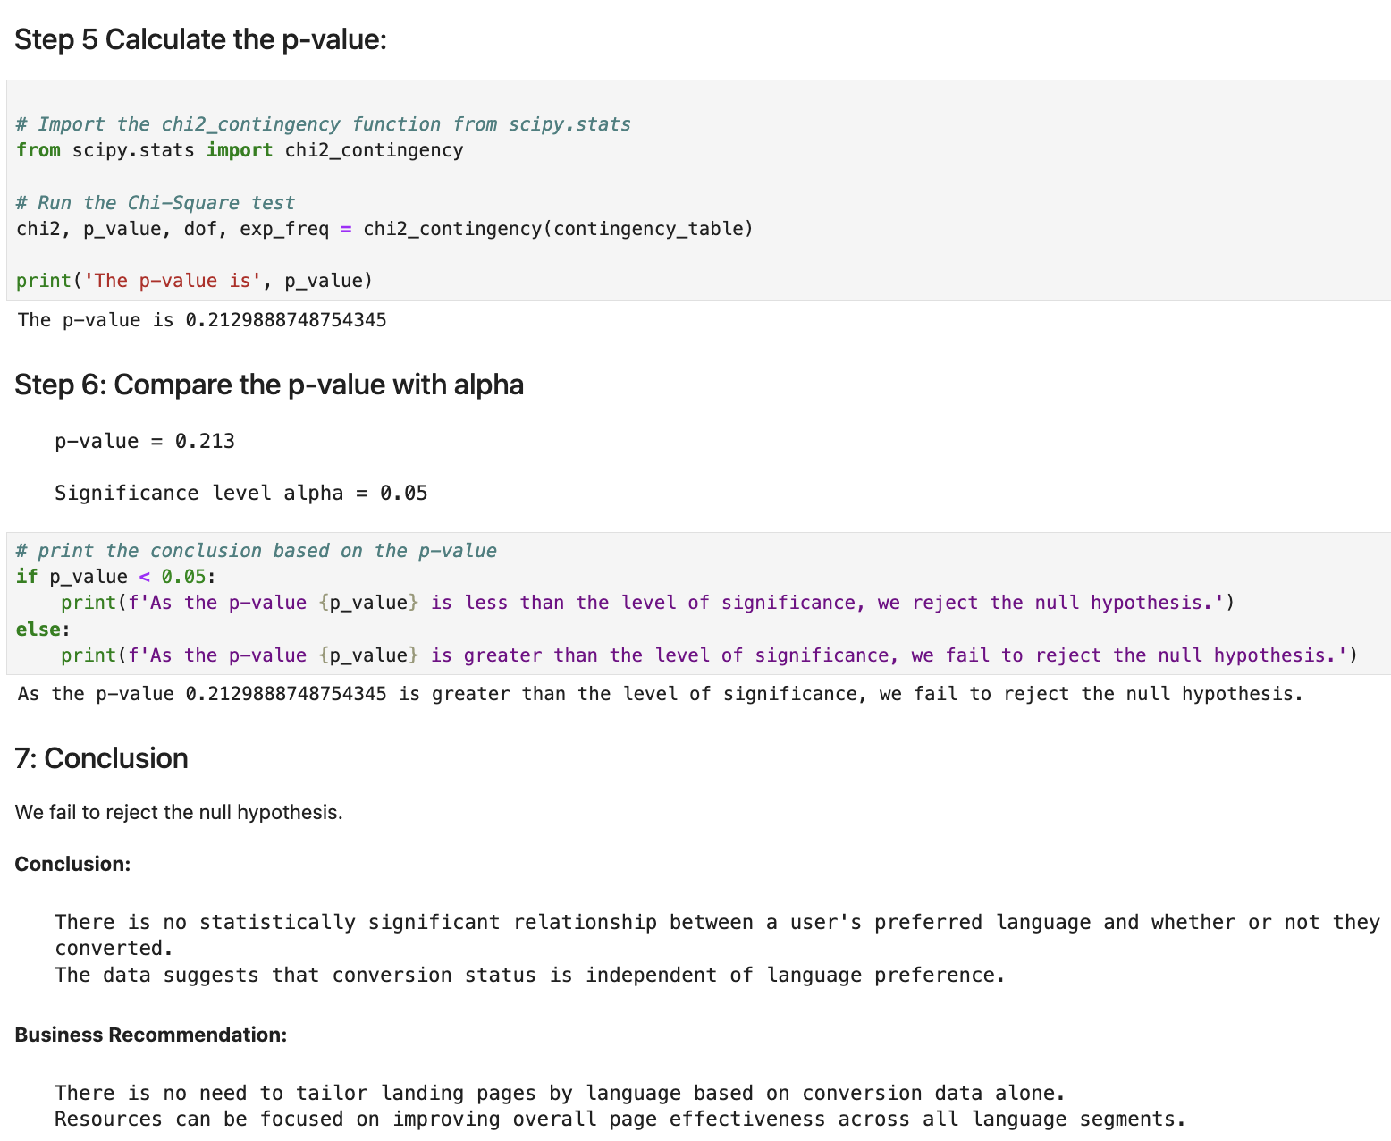
Question 3 Hypothesis Testing Details

Slide 46
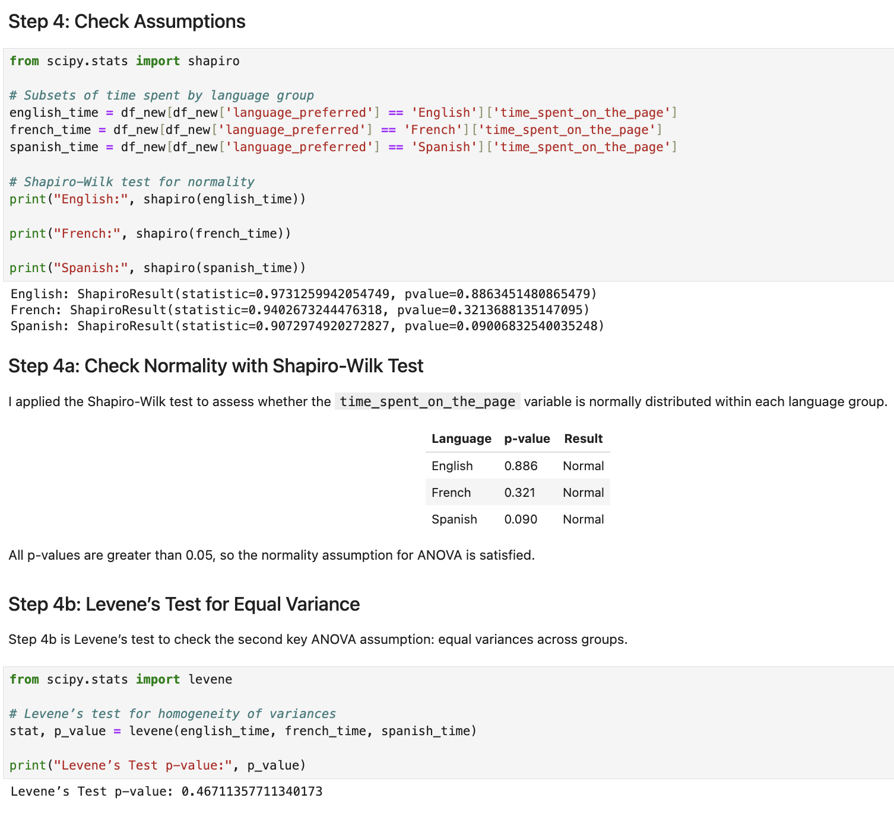
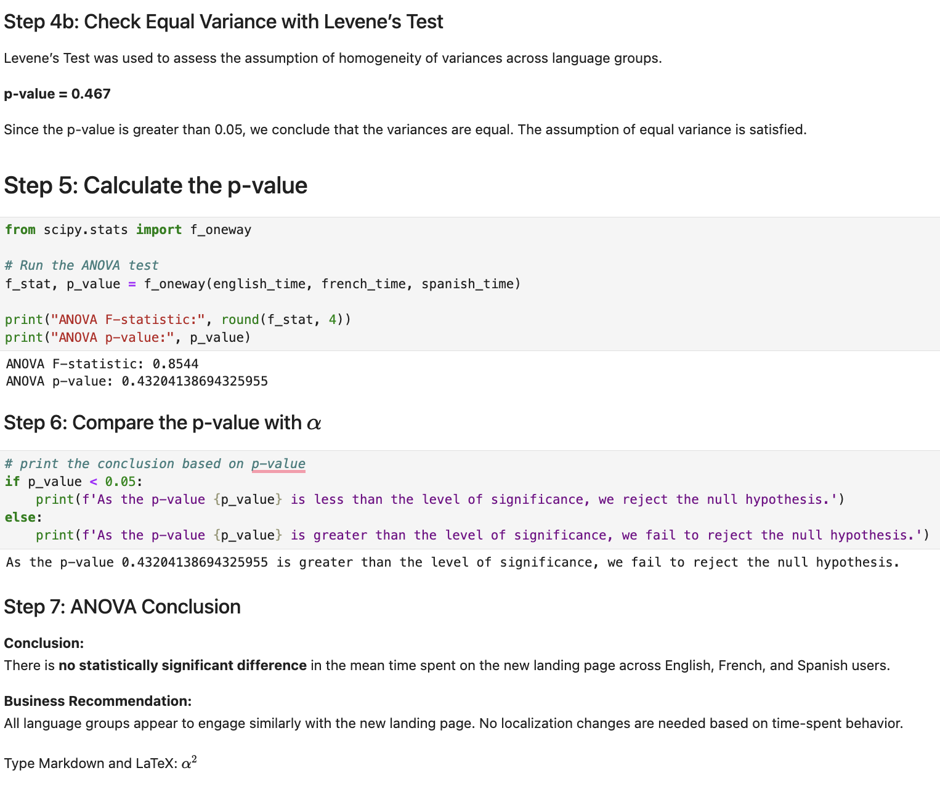
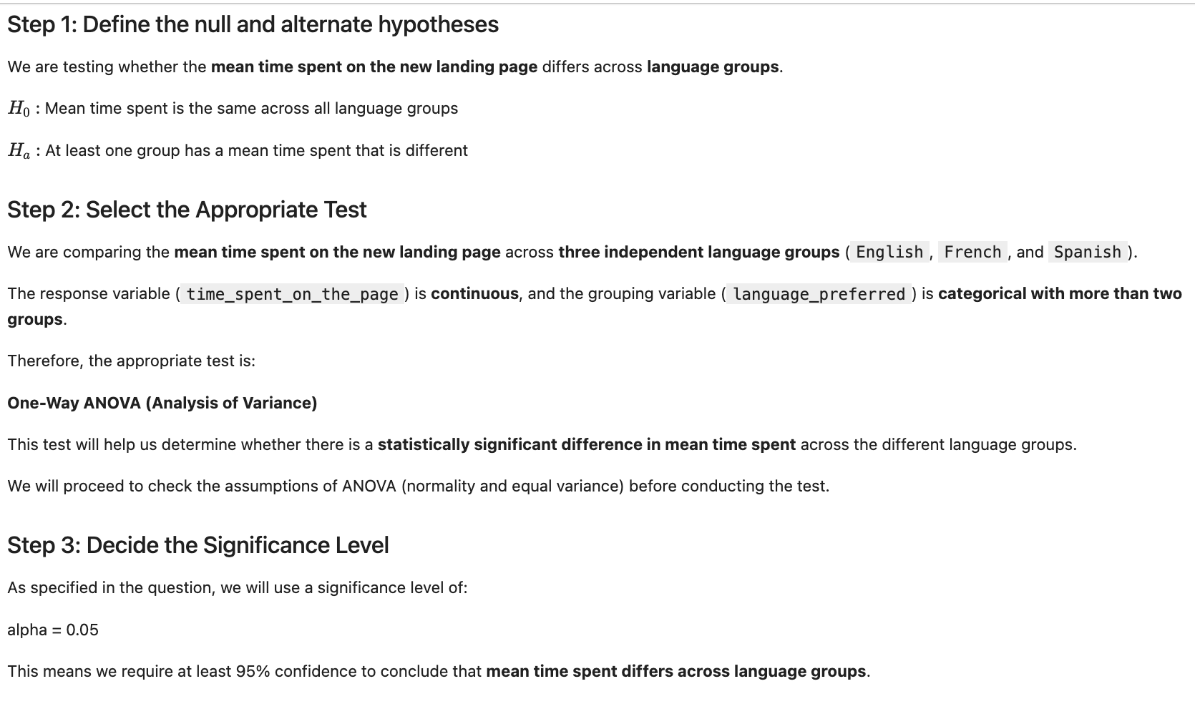
Question 4 Hypothesis Testing Details

